Slide 1
IE 6700 – DATA MANAGEMENT FOR ANALYTICS
HOSPITAL MANGEMENT SYSTEM
Study Group: 4
Submitted By: Mina Kazemi,
Kiran Priya Chigurupati,
Priyanshi Rastogi

Slide 2
Introduction
Dealing with massive amounts of data has become a difficulty in modern companies. It's challenging to retrieve such a large amount of data. SQL has been widely utilized to address this problem; using SQL, you can study data and do any data-related tasks.
In this project, we'll look at the hospital management dataset in order to do some research and exploration. The hospital is one of the institutions where managing information is extremely difficult; each day, the hospital sees a large number of patients, and it is difficult to keep track of such a large quantity of data, therefore developing a database would be beneficial.
In the course of a day, hospitals interact with a large number of people and engage in a variety of activities. Booking appointments, maintaining doctor schedules, tracking patient diagnoses, and managing patient medical histories are just a few examples. All of this necessitates the use of the appropriate database.

Slide 3
Purpose of the project:
• Create a database to keep a record of staff and patient information.
• Create a system that focuses on improving hospital processes.
• Creating a system that provides better service to patients
• Creating a system that provides better service to patients
• The data contains details such as patients' appointments, billing information, and disease history
• The database record assists the hospital in tracking their staff activities and scheduling staff members according to needs.

Slide 4
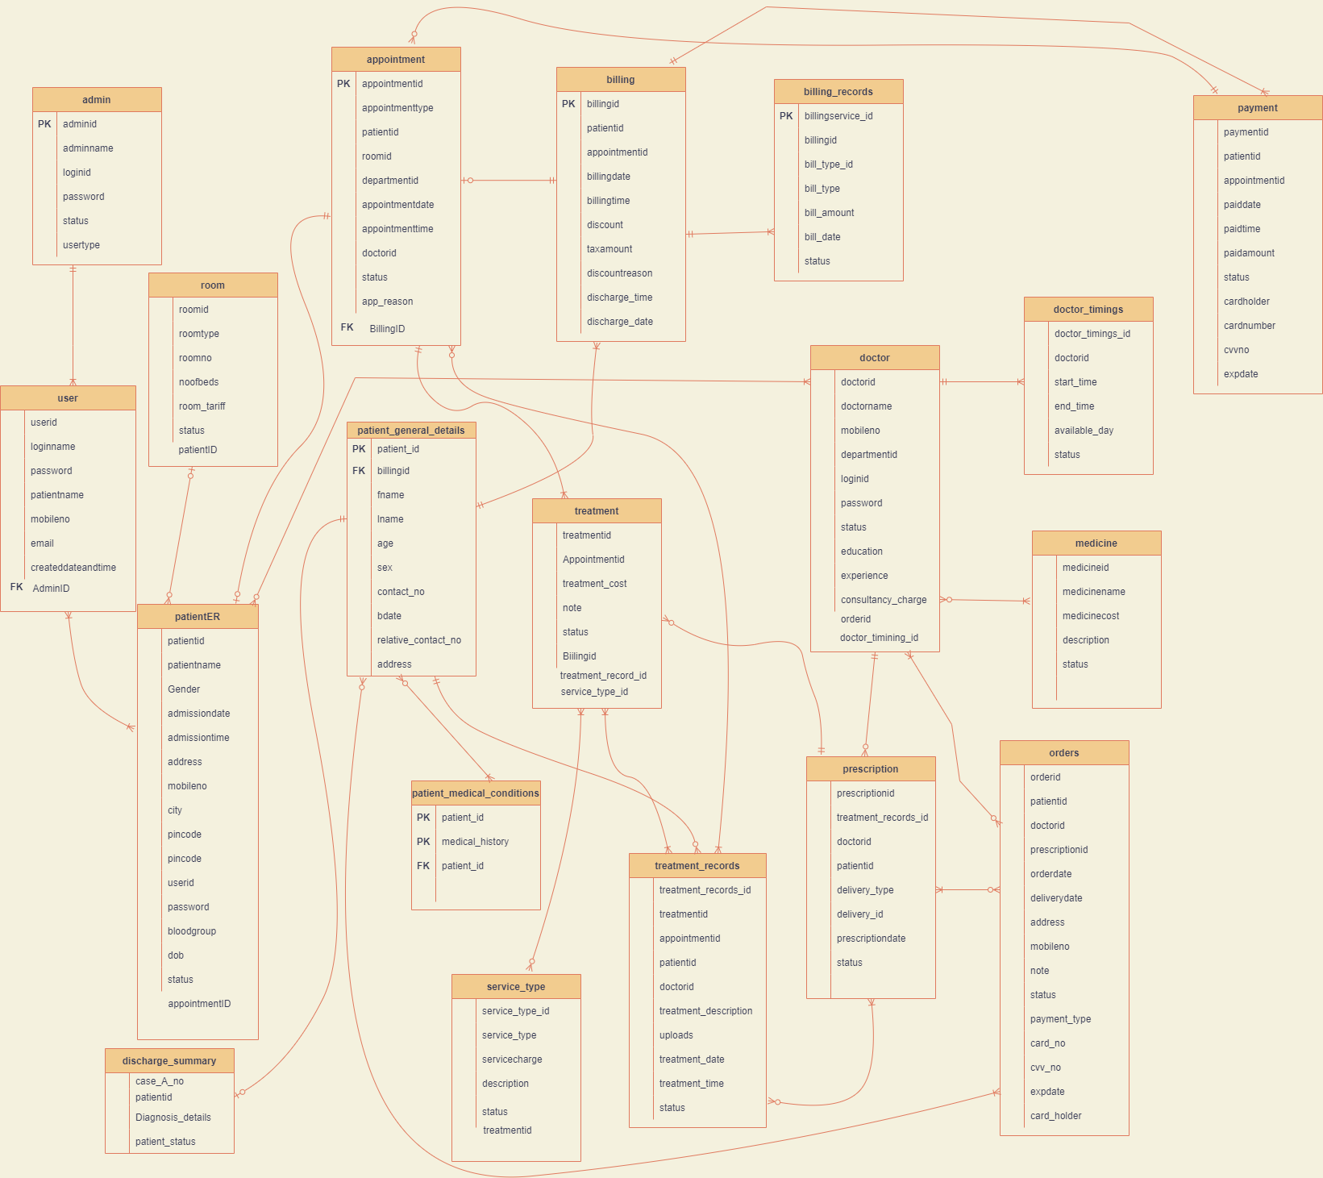
Entity Relationship Diagram (ER model):

Slide 5
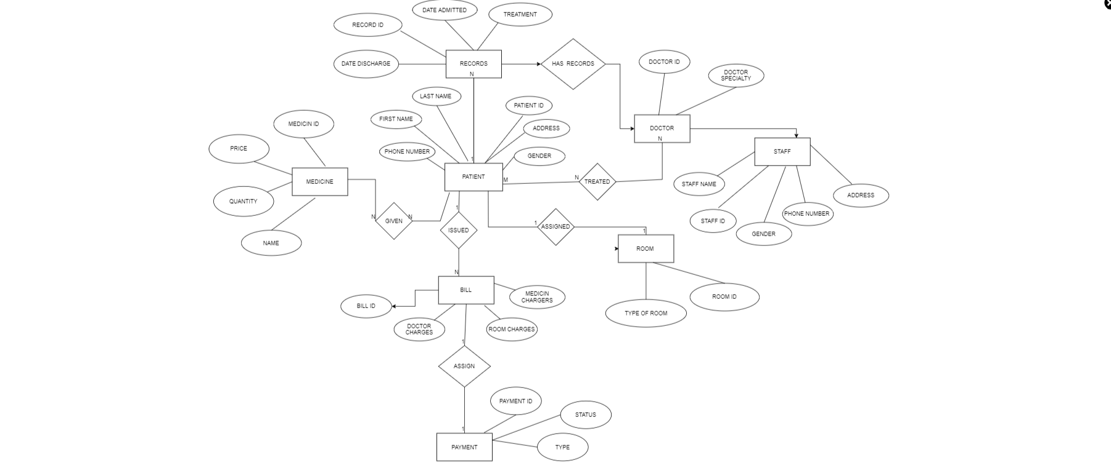
Unified Modelling Language (UML) class diagram:

Slide 6
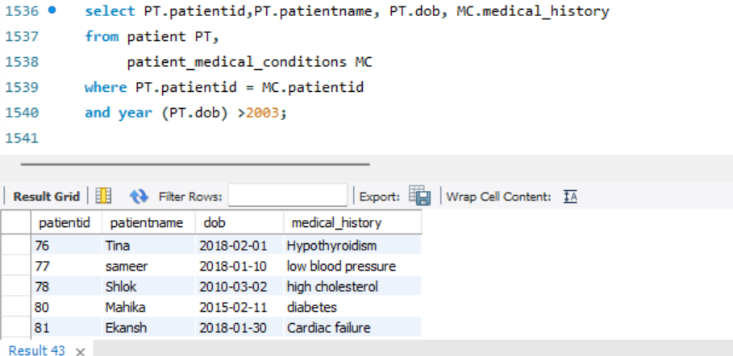
Implementation in MySQL
Query 1 : Display all patients below the age of 18 along with their medical history

Slide 7
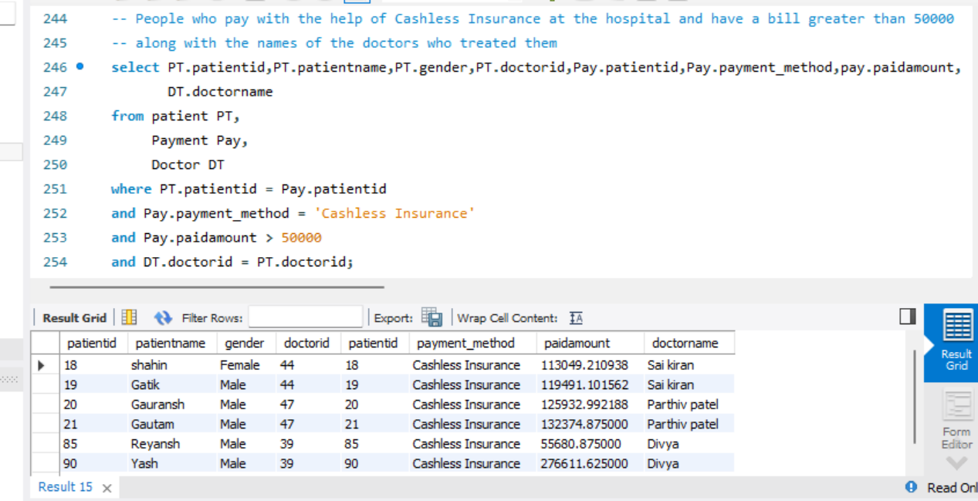
Query 2 : Display all patients who have cashless insurance and have paid bills greater than 50000 to the hospital via cashless insurance payment method and which doctors assisted them in their treatment

Slide 8
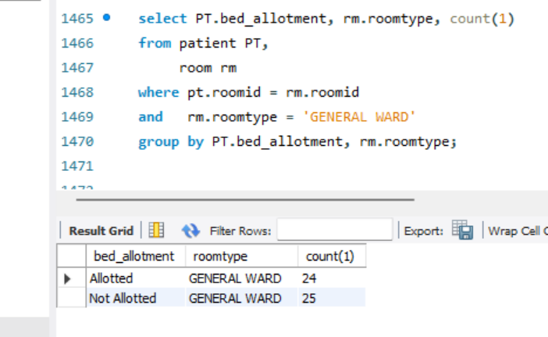
Query 3 : Count of all patients in the general ward who have received bed allotment vs who have not received bed allotment

Slide 9
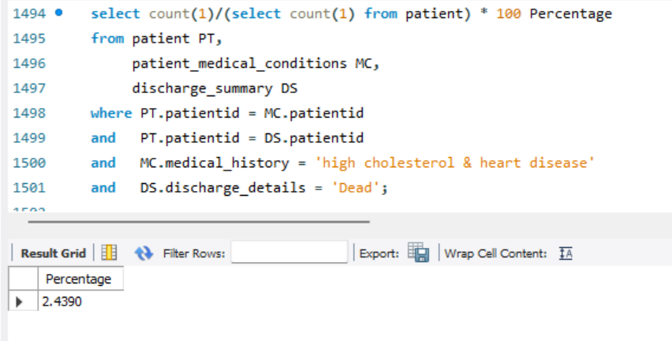
Query 4 : Percentage of patients who have a medical history of high cholesterol and heart disease and have died in the hospital.

Slide 10
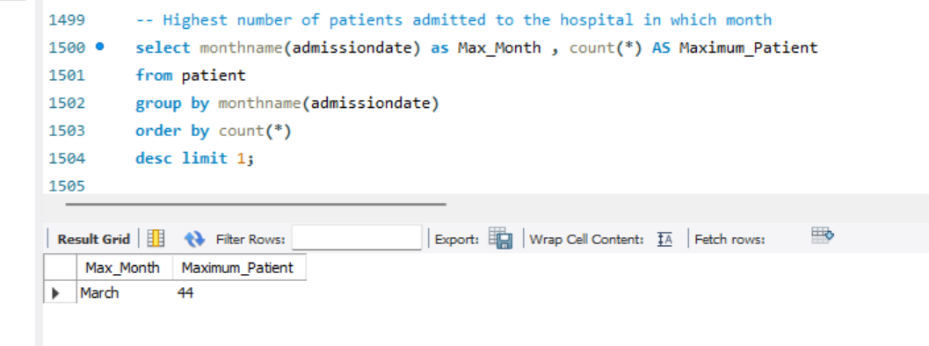
Query 5 : Highest number of patients admitted to the hospital in which month

Slide 11
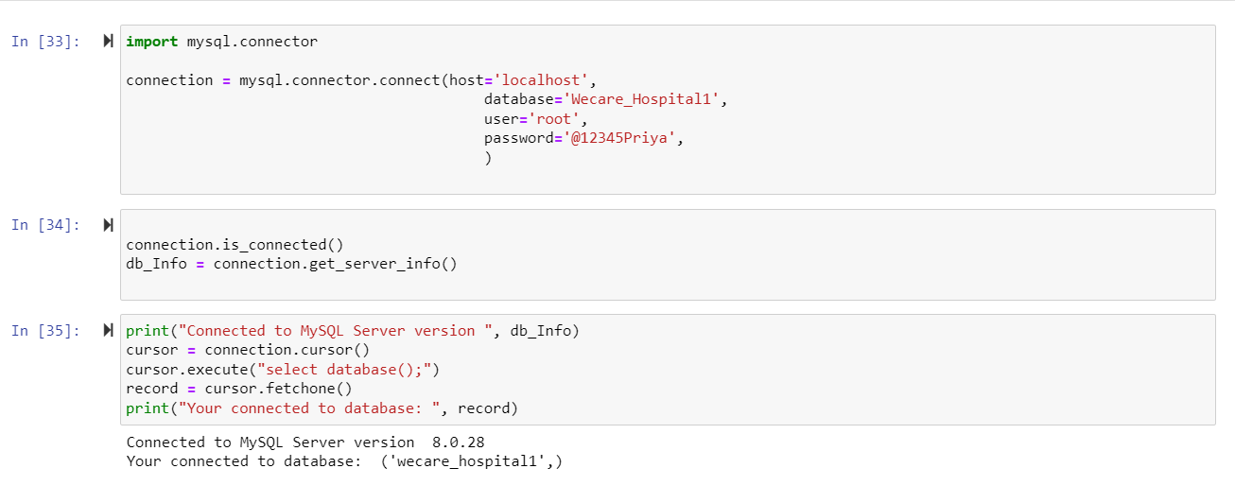
Database Access via Python
Step 1

Slide 12
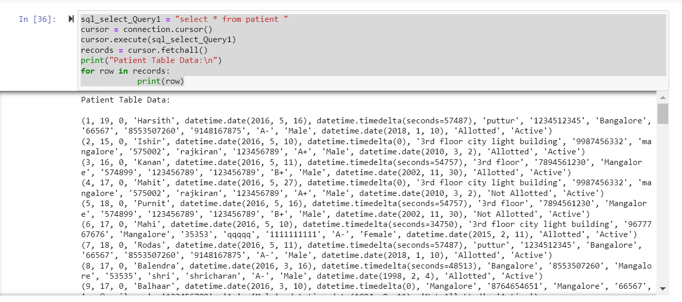
Step 2

Slide 13
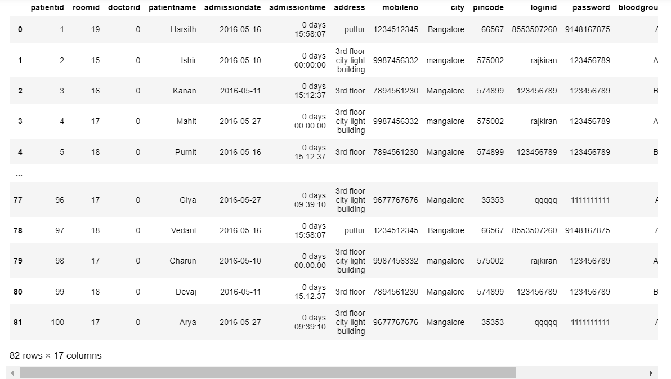

Slide 14
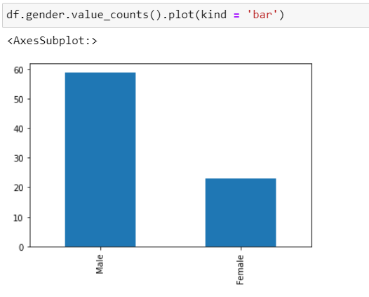
Step 3

Slide 15
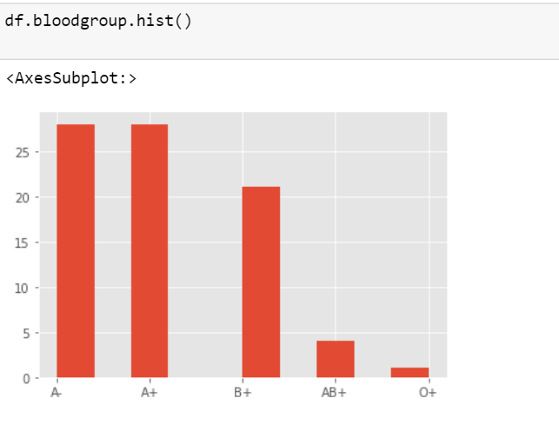
Step 4

Slide 16
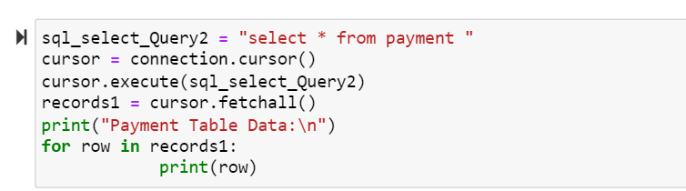
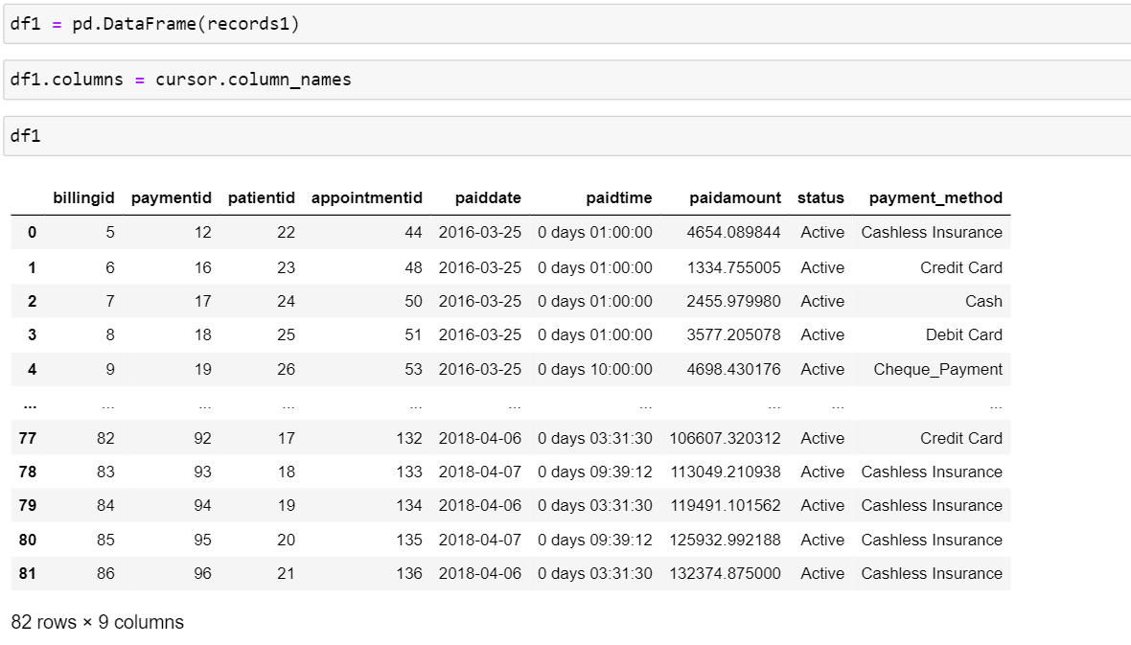
Step 5

Slide 17
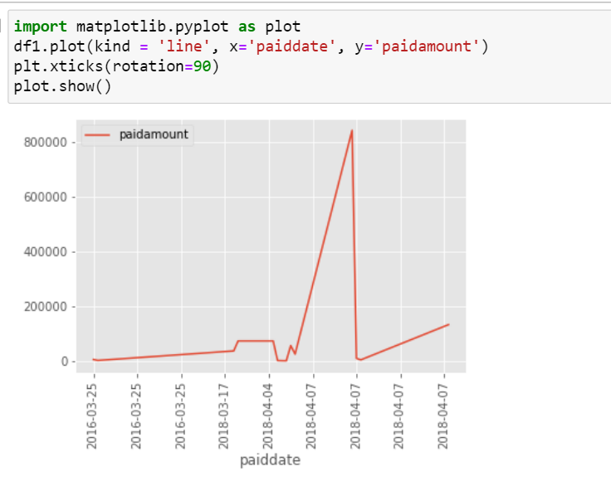
Step 6

Slide 18
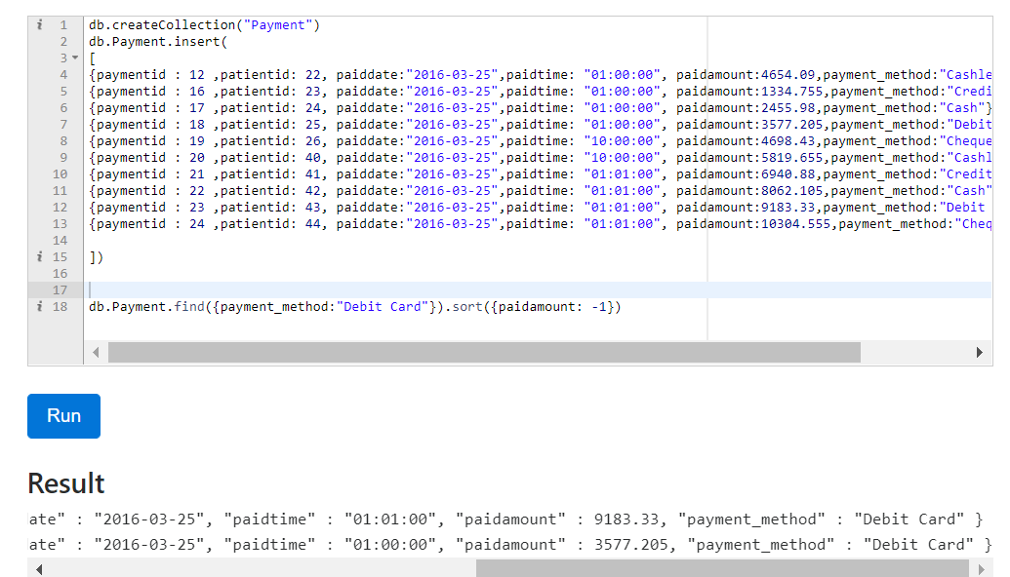
Implementation in NoSQL using MongoDB
db.Payment.find({payment_method:"Debit Card"}).sort({paidamount: 1})
Query 1

Slide 19
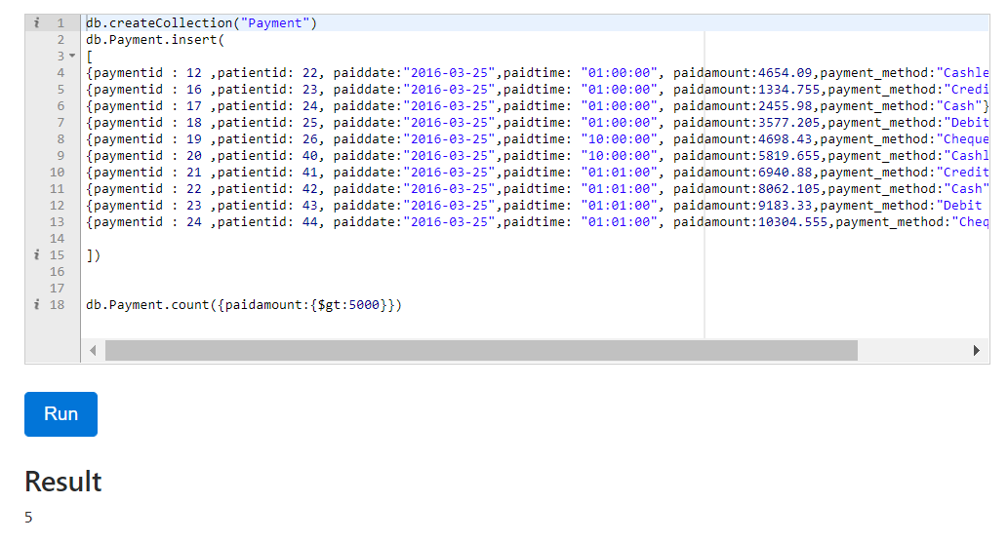
Query 2
db.Payment.count({paidamount:{$gt:5000}})

Slide 20
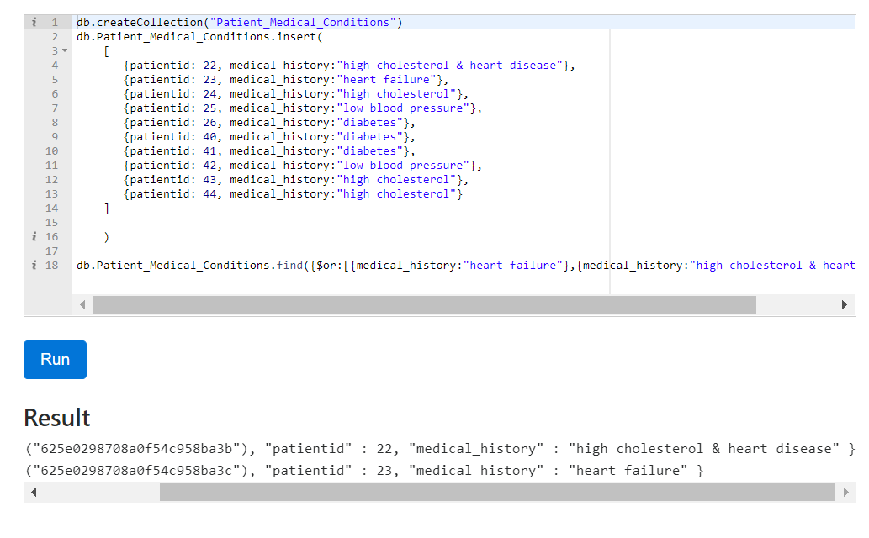
db.Patient_Medical_Conditions.find({$or:[{medical_history:"heart failure"},{medical_history:"high cholesterol & heart disease"}]})
Query 3

Slide 21
conclusion
Data will be secure since we will be entering patient information into the "Hospital management system" online. We may access a patient's history with a single click using this program. As a result, information will be processed more quickly. It ensures that patient information is kept up to date. It easily minimizes the process of bookkeeping, reducing human effort and increasing accuracy speed.
A hospital management system is necessary for keeping track of information regarding the doctor, the patient, and the hospital staff, among other things. We recognize that by utilizing the hospital management system project, our job has been easier and we have saved a significant amount of time. Administrators at hospitals would be able to increase operational control and hence simplify operations. Because it automates the process of collecting, compiling, and retrieving patient information, this would allow for a faster reaction time to the needs of patient care. Accounting may be depressing and complicated at times. This product will take care of all of that.

